Slide 1

CareerCrafter Resume Analyzer
Capstone Project
Review 3
Devyansh Rajput 22MCA10061

Slide 2
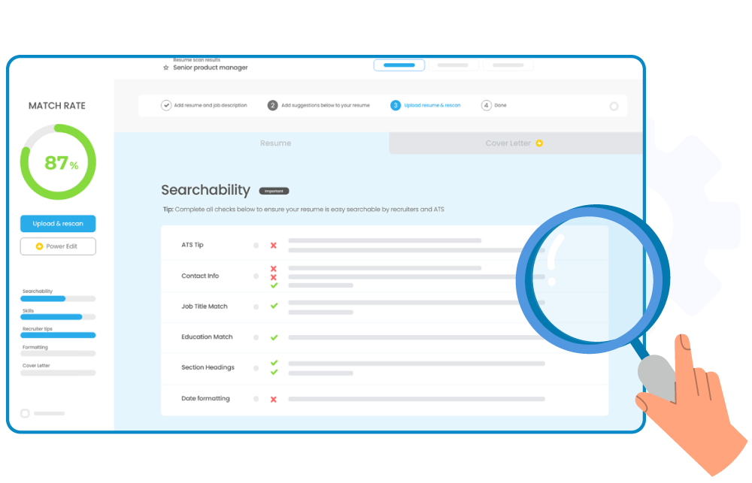
Content
Introduction
Problem-Solving Approach
Methodology Used
Modern Tool Usage
Design and Implementation
Ethics & Environmental Consideration
Social Relevance
Conclusion

Slide 3

Introduction
CareerCrafter, is a tool that aims to assist job seekers in their pursuit of professional growth by providing customized guidance.
CareerCrafter is a resume analyzer designed to transform the job application process by providing personalized insights and recommendations to job seekers.
CareerCrafter is more than just a tool, it is a career companion that helps job seekers achieve their career goals.
CareerCrafter aligns with this trend by analyzing skills and providing recommendations for skill enhancement.

Slide 4

Problem-Solving Approach
CareerCrafter is a strategic partner that offers tailored advice, positioning job seekers for success in a competitive market.
As the job market continues to evolve rapidly, CareerCrafter has emerged as a solution to help job seekers bridge the gap between their skills and their ideal career paths.
The AI-powered tool analyzes resumes with precision and provides personalized feedback and actionable steps for career advancement.

Slide 5
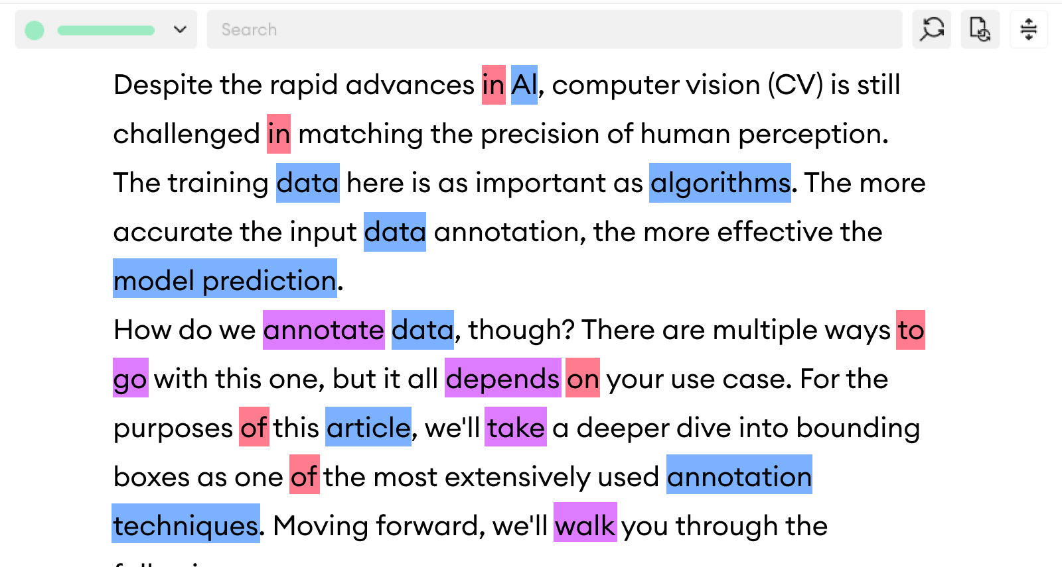
Methodology Used
CareerCrafter employs a data-driven methodology, utilizing advanced algorithms and natural language processing to dissect and interpret the complexities of a resume.
The data-driven approach ensures a thorough analysis, catering to the diverse needs of job seekers.
The methodology behind CareerCrafter is meticulous and data-centric. It involves :
Parsing resumes with precision.
Extracting information using advanced text mining techniques.

Slide 6

Modern Tool Usage
Leveraging cutting-edge tools and technologies, CareerCrafter stands at the forefront of resume analysis.
Python's powerful libraries and MySQL's robust database capabilities come together to create a seamless and efficient user experience.
CareerCrafter harnesses modern tools to deliver a state-of-the-art experience :
Python for backend logic and data processing.
MySQL for robust data storage and retrieval.
Streamlit, JavaScript, HTML, and CSS for a dynamic and responsive front end.

Slide 7

Design and Implementation
The design philosophy of CareerCrafter is rooted in simplicity and effectiveness.
The user interface, crafted with Streamlit, HTML, CSS, and JavaScript, offers an intuitive experience, while the backend, powered by Python, ensures a potent analytical engine.
The design of CareerCrafter is sleek and user-friendly, while its implementation is robust and scalable. It features:
A clean, intuitive interface that guides users through the resume analysis process.
A backend architecture designed for performance and reliability.

Slide 8

Ethics & Environmental Consideration
Ethical and Environmental considerations are paramount in CareerCrafter's development.
CareerCrafter adheres to ethical standards by:
Ensuring user consent for data usage.
Following best practices for ethical AI and machine learning.
By optimizing our code and reducing server load, we aim to minimize our carbon footprint, reflecting our commitment to sustainability.
Continuous optimization efforts aim to decrease the computational resources required for analysis.

Slide 9

Social Relevance
CareerCrafter is socially relevant, providing equitable access to career development tools.
It democratizes professional growth, offering insights that were once the domain of industry insiders.
CareerCrafter is socially impactful, as it:
Provides equal opportunity for all job seekers to improve their resumes.
Offers insights that can help reduce unemployment and underemployment.
Bridges the gap between education and employment by aligning skills with market needs.

Slide 10

Conclusion
CareerCrafter, is a tool that aims to assist job seekers in their pursuit of professional growth by providing customized guidance.
CareerCrafter is a strategic partner that offers tailored advice, positioning job seekers for success in a competitive market.
CareerCrafter employs a data-driven methodology, utilizing advanced algorithms and natural language processing to dissect and interpret the complexities of a resume.
Leveraging cutting-edge tools and technologies, CareerCrafter stands at the forefront of resume analysis.
CareerCrafter is socially relevant, providing equitable access to career development tools.

Slide 11

THANK YOU!
Devyansh Rajput
Reg No:
devyanshrajput2022@vitbhopal.ac.in
Email:
22MCA10061

